Slide 1
Stock Price Prediction with LLM Fine tuning
By Group 12
LIU Yang; ZHU Jingwen; LI Keyu; LI Yingxuan; YANG Zhe; MENG Sihao

Slide 2
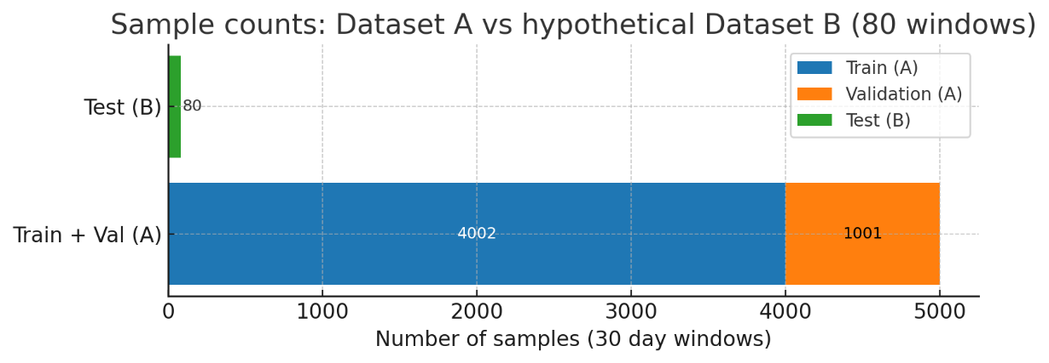
Dataset
Dataset B ‘sample_test.csv’
*Separate stock time series
*Same structure as Dataset A
*30 input windows, horizon 3 days
*For final three day RMSE
Dataset A Nvidia stock prices
*Source: Yahoo Finance, Kaggle
*Time span: 2004/01/02 to 2023/12/29
*Rows: 5033 trading days
*Columns: Date, Open, High, Low, Close, Volume
*Preprocessing:
Sort by Date
Select features
Sliding window length 30
Target is next day normal return
*Split: 80% train; 20% validation
Dataset A -> train / val
Dataset B -> test
Train / Val / Test ≈ 79:20:1

Slide 3
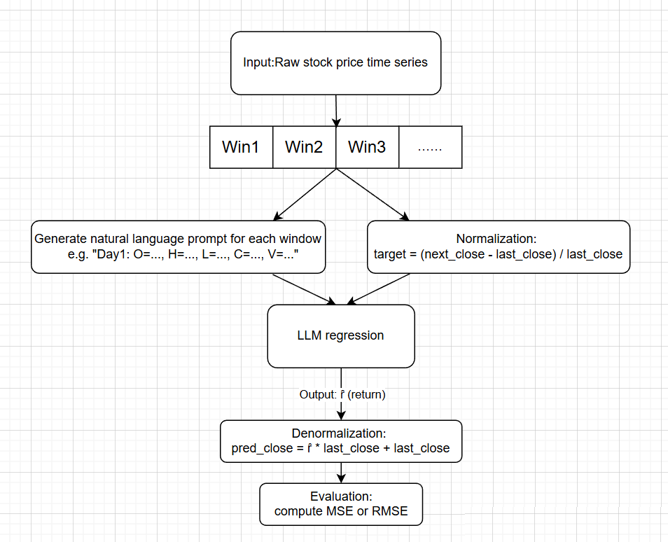
Sliding window and LLM regression
Linear sliding windows
window_size = 30
Normalization target:
used as the training label for LLM regression
Denormalization converts the predicted return back to the actual price

Slide 4
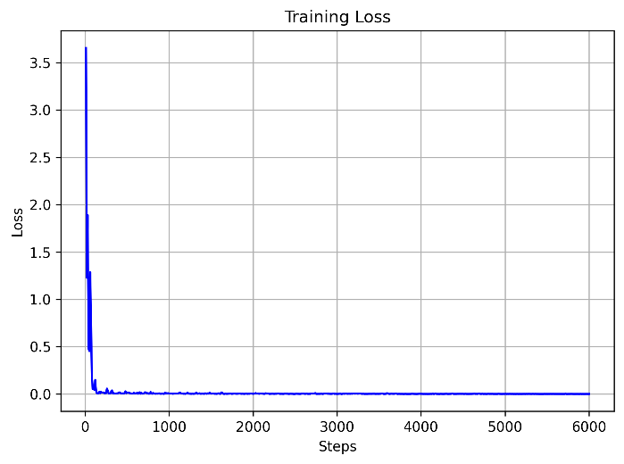
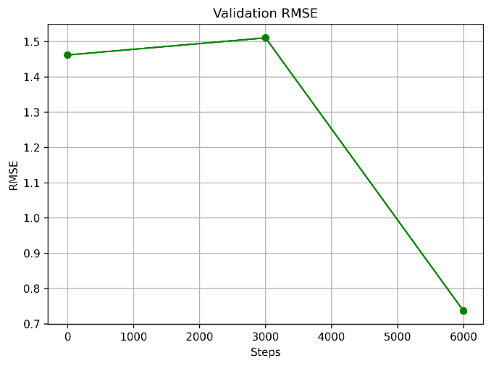
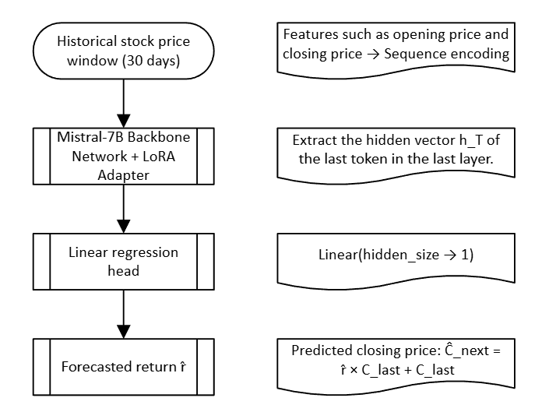
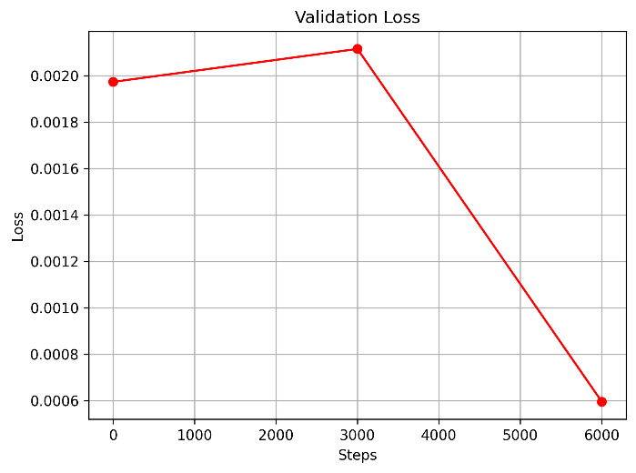
LORA model based on Mistral
From Text Generation to Regression Prediction: Mistral-7B + LoRA in Practice on NVDA Stock Price
Attach a lightweight linear regression head to the last hidden state.
Directly output the numerical prediction results.
Configuration Item | Setting
Window Length | 30 trading-day sequence
Batch Size | 2
Learning Rate | 2 × 10⁻⁴
Total Epochs | 3 (≈ 6003 steps)
Loss Function | Huber Loss (Smooth L1)
Peak GPU Memory | ≈ 13.7 GB
Notes: This linear regression head is a unified configuration for all models (based on the initial code framework) and is not exclusive to lora_mistral

Slide 5
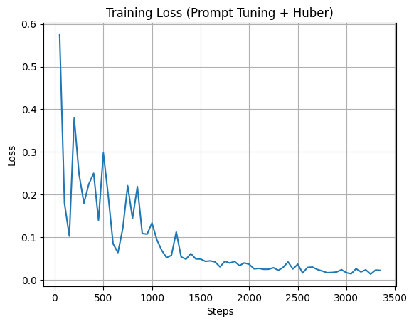
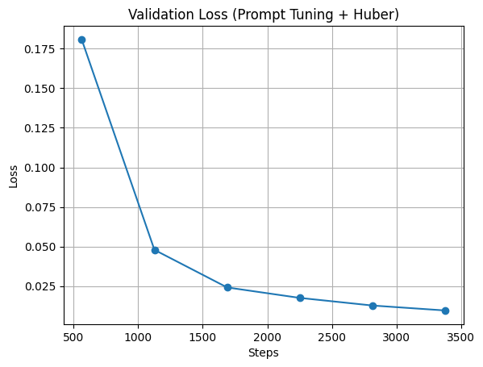
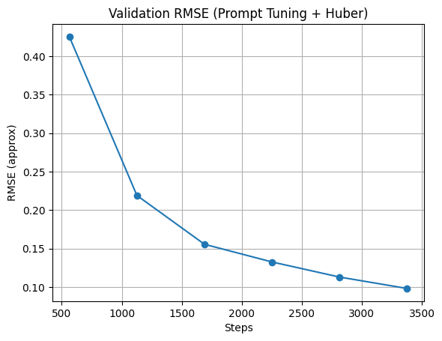
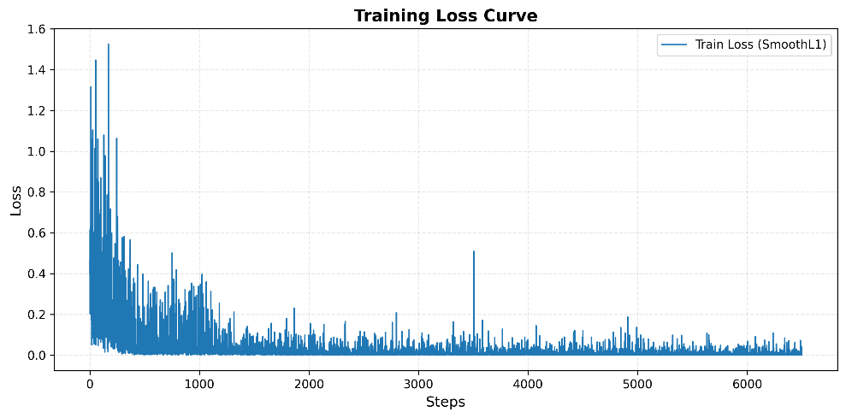
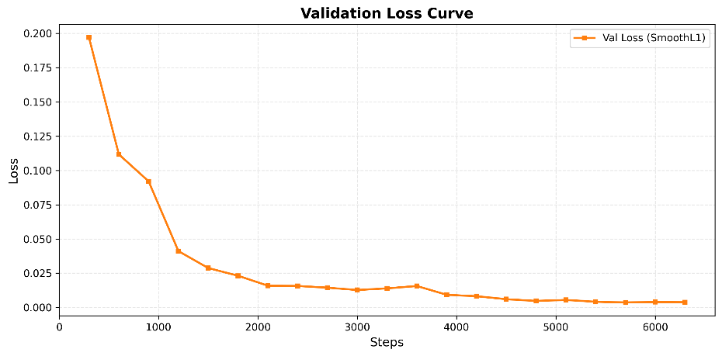
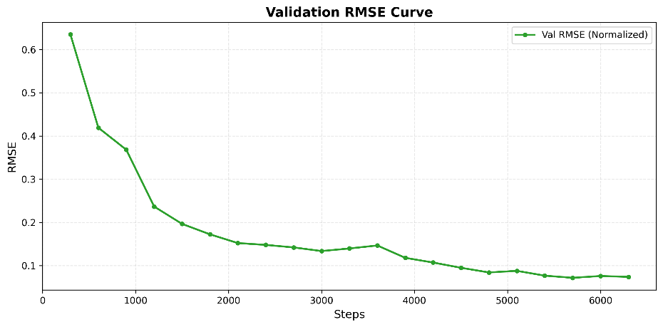
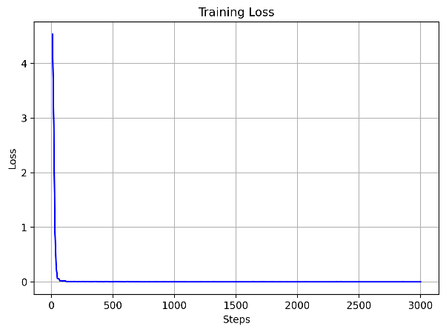
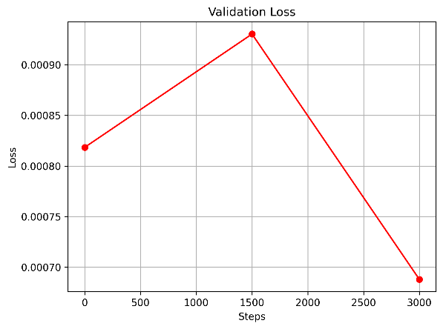
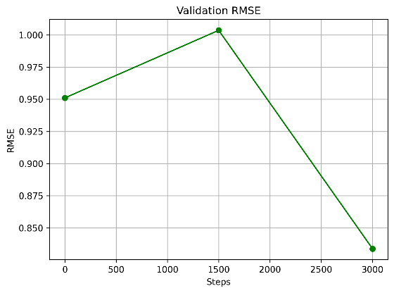
About other three GPT-2 models
Prompt Tuning + Huber
IA³
LoRA

Slide 6
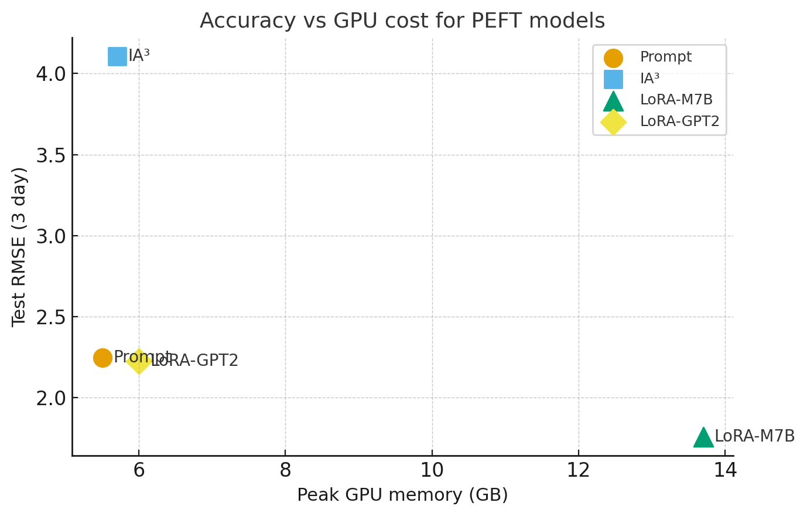
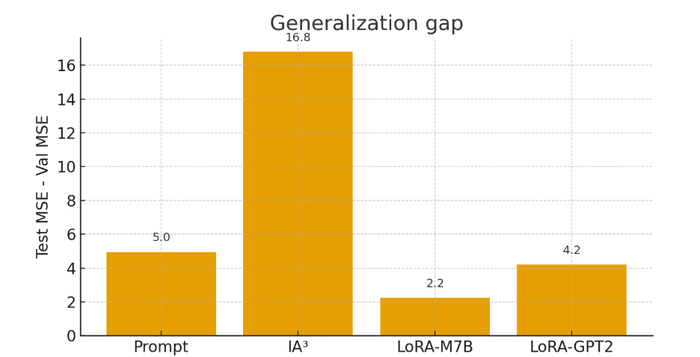
Comparison of results from four models
Model | Val_mse | Test_mse | Gpu_peak_value
Prompt Tuning (GPT-2) | 0.10 | 5.05 | 5..5GB
IA³ (GPT-2) | 0.07 | 16.86 | 5.7GB
LoRA (Mistral-7B) | 0.85 | 3.09 | 13.7GB
LoRA (GPT-2) | 0.74 | 4.95 | 6.0GB
Notes:
Mistral-7B + LoRA
Key Takeaways
• Best Generalization Ability: Test MSE = 3.09, the best among the four methods, demonstrating strong generalization
Validation-Test Discrepancy: Validation MSE is relatively high (0.85), but test performance is best, suggesting possible underfitting on validation set but strong generalization
Highest Resource Demand: GPU memory usage is 13.7GB, due to the larger Mistral-7B base model

Slide 7
Conclusion and Future directions
What we did
1. LLM as a regression engine for stocks
Turn Mistral into a regression model by adding a small linear head on the last hidden state.
2. Unified comparison of three PEFT methods on two backbones
Evaluate LoRA(Mistral 7B), LoRA(GPT2), IA³(GPT2) and Prompt tuning(GPT2) .
3. Reusable training and testing scripts
Standardize 'train _normalize.py’ and 'test.py’ so any future model can plug into this framework easily.
What could be improved next
1. Train on multiple stocks and richer targets
2. Improve multi step forecasting head
3. More realistic evaluation metrics: MAPE, direction accuracy

Slide 8
Statement of contribution
Li Keyu is responsible for selecting the base LLM model and training dataset, designing the network architecture for stock price prediction, and writing the LoRA finetuning code. She also prepared the experiment report and code documentation.
LIU Yang implemented the LoRA GPT2 model, debugged the code, and produced the corresponding experimental results.
ZHU Jingwen implemented the IA³ GPT2 model, ran experiments, and followed up on additional runs and refinements.
MENG Sihao built the Prompt Tuning GPT2 model and conducted experiments with different loss functions.
LI Yingxuan prepared the slides, organized the experimental statistics, and participated in the final presentation.
YANG Zhe prepared the slides, visualized the results, aggregated data, and joined the presentation.

Slide 9
Thank you!

